Slide 1
INSPIRING WOMEN
Düzce Anadolu İmam Hatip Lisesi
TÜRKİYE

Slide 2
Düzce Anadolu İmam Hatip Lisesi (Fen ve Sosyal Bilimler Proje Okulu) 2018

Slide 3
Our School is a high school in a small city named Düzce .
The age of our students are between 14 and 18.
We have about 500 students in our school.
There are 40 teachers, two manager assistants and a scool principal.

Slide 4
Our students settle in by a nation wide exam to our school.
The students can study science , liberal arts and foreign languages and sports.
There are laboratuaries, informatics classes, robotic coding workshops in our school.

Slide 5
Our students are competent in the fields of religion,
science, art and culture that our country and the world need
can evaluate the cultural heritage, interpret the life, produce solutions to problems,
have moral maturity, are well-equipped with the beliefs and principles of the Islamic religion,have a broad horizon, and we prepare them for higher education and religious services as individuals who are aware of the world's problems.

Slide 6
Our Principles-1
Belief in success
Disciplined and planned education
Being open to criticism
4. Equality of opportunity

Slide 7
Our Principles-2
Quality in education
Being open to communication
School-family cooperation
Active learning
Disciplined work
Participation in decision making

Slide 8
TÜRKİYE

Slide 9
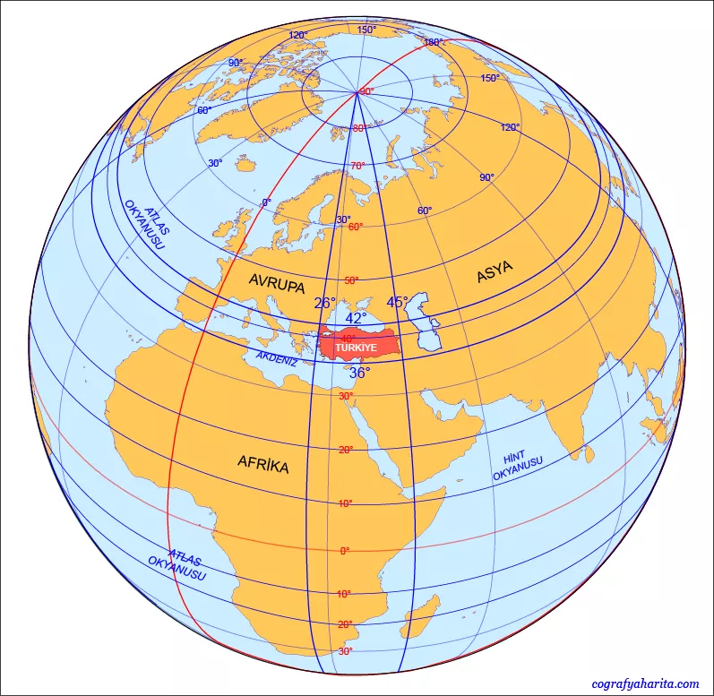
LocatIon Turkey Is The Only Country That Is On Two Continents. As It Is Located On Both Asia And Europeancontinents. It Is Bordered By Eight Countrıes Which Are; Bulgaria, Greece, Georgia,armenia,azerbaijan And Iran.

Slide 10
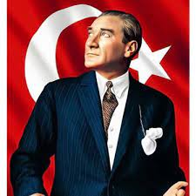
HISTORY Turkey Is Founded In 1923 By Atatürk. It Is Governed With Republic. Various Civilizations Lived On This Location. Different nations live in Türkiye for years. People in Turkey are known by their Hospitality, Helpfulness, Honesty, Diligence and Sincerity Due to its location a lot of immigrants pass from Turkey.

Slide 11
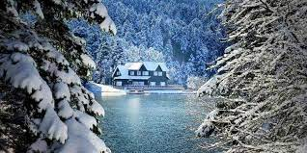
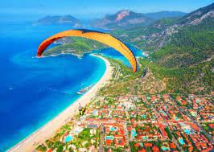
Clımate
You Can Live 4 Seasons In Turkey.
It Has Various Touristic Places.
It is Sorrounded By Sea From Three Sides.

Slide 12
Turkey’s Spectecular cıtıes
Ankara(capıtal)
Nevşehir
İstanbul
İzmir

Slide 13
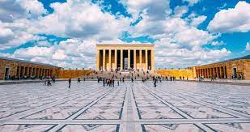
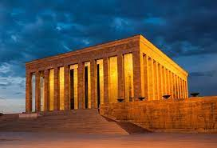
Ankara
Even though foreign people always consider Istanbul as the capital of Turkey, indeed, Ankara is the actual capital of Turkey.
•Ankara is especially famous with Anıtkabir, a building which is a national symbol for us, where our founder Mustafa Kemal Atatürk lies within.
•Over 5 million people are living in Ankara.

Slide 14
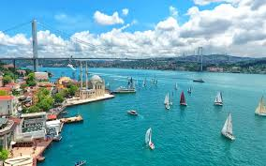
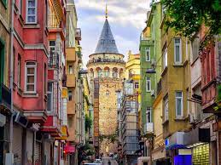
İSTANBUL
Istanbul is the largest city of Turkey with its 15 million population.
In Istanbul, there are a lot of historical buildings, museums and shopping centres. It also connects Asia and Europe.
One of the most beautiful buildings of Istanbul is Galata Tower with its legend which claims that a man and a woman who go to the Galata Tower for the first time, would certainly get married.

Slide 15
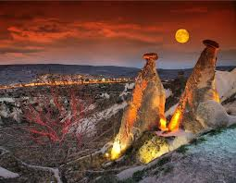
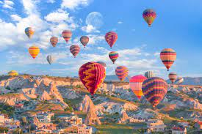
NEVŞEHİR
Nevşehir is famous with its hot air balloons which help us to observe the beauty of landscape that is created by Cappadocia region.
Cappadocia region is the most beautiful place that is made by the combination of nature and history. It emerged when the soft layers that was formed by lava and ashes got wore out by the rain and wind 6 million years ago.

Slide 16
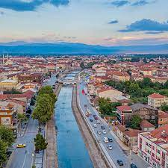
DÜZCE
Düzce is a small city reputed with its traditional meals like haluj, corn bread and nut.
It is also known with its streams which you can have some fun by israfting.
The population of Düzce is about half million peole.

Slide 17
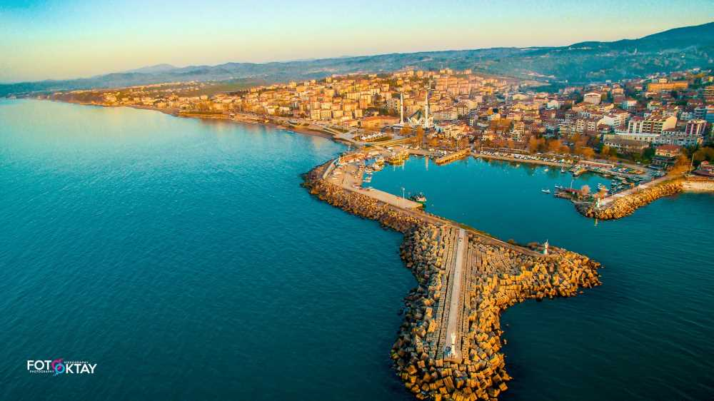
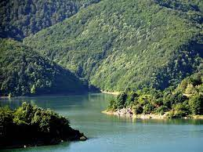
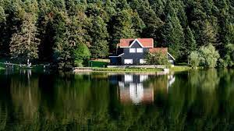
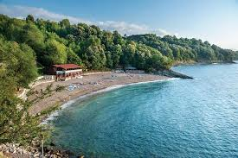
DÜZCE
In Düzce you can see historical places (Prusias Ancient Site) and natural places (Abant Lake and Natural Park, Güzeldere Waterfall)

