Slide 1
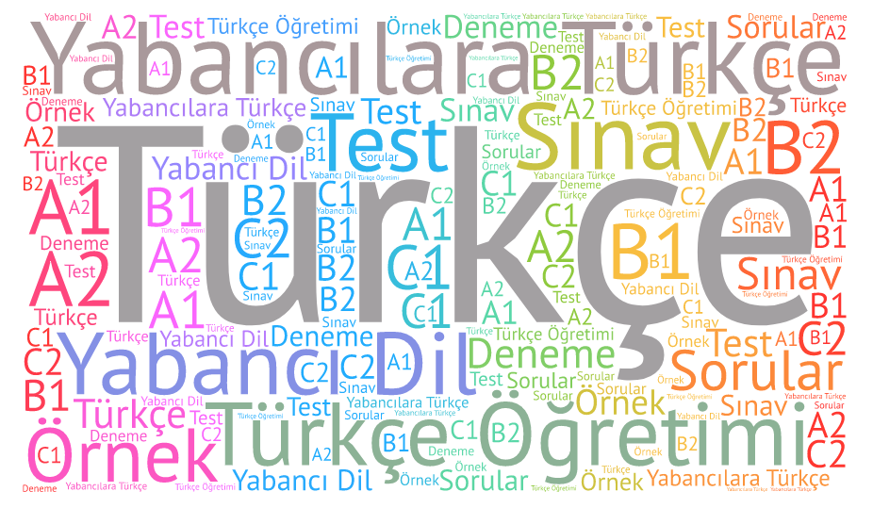
GRADES 9TH TO 10TH ENGLISH ARABIC AS A FOREIGN LANGUAGE
INTEGRATION OF LANGUAGES

Slide 2
LANGUAGE LEVEL : B1/B2 DURATION : 3 WEEKS (FEBRUARY 20 th – march 10 th)

Slide 3
arabıc orıgın words ın englısh language usage of these words ın turkısh language usage of these words ın verses of koran
focus

Slide 4
Gatherıng ınformatıon about mutual words fılterıng mutual words gettıng to know cultural ınteractıon co-operatıon ıntegratıng knowledge acquıred ın dıfferent languages
SKILLS TO BE DEVELOPED

Slide 5
POSTER FOR HISTORICAL PAST OF WORDS EXCHANGE ARTFUL POSTER FOR OFFLINE EXHIBITION AT SCHOOL WORKSHEETS ON MUTUAL WORDS IN ARABIC, ENGLISH AND TURKISH AN E TWINNING CLIPBOARD FOR EXHIBITION SETTING THE CLIPBOARD WITH PREPARED MATERIALS
ACTIVITIES

Slide 6
WITHIN THE SCHOOL : SELF ASSESSMENT OF MEETING THE GOALS, RESEARCHES WITH PARTNERS : SHARING KNOWLEDGE, MAKING RESEARCH ABOUT ORIGINS OF WORDS AND INTERACTION OF LANGUAGES
OUTCOMES

